Slide 1
Internetworking Technologies & Services (I)
Overview
  Definitions
  Internetworking Architecture Models
  Internetworking Standards
  Network Terminology

Slide 2
Definitions
Proprietary Systems
  Privately owned and operated
  Held under patented, trademark, or copyright by a private person or company
De facto Standards
  Existing or being such in actual fact though not by legal establishment
  Official recognition
Standards
  Something established for use as a rule or basis of comparison in measuring or judging capacity, quantity, content, extent, value, quality, etc.

Slide 3
Definitions
Rules and conventions for the exchange of information
  Open Systems
Who makes the rules and conventions?
  Many local, regional, and international organizations
  ISO, ITU, IEEE, ANSI, ECMA

Slide 4
Internetworking Architecture Models
OSI Model
3-Layer Model
TCP/IP Model

Slide 5
OSI Model
International Organization for Standardization (ISO)
  Open System Interconnection (OSI) Model, provides a framework
Application
Presentation
Technology independent
Session
Transport
Boundary
Network
Data Link
Technology dependent
Physical

Slide 6
OSI Model
Data transfer
Data
Application
Application
Presentation
Presentation
Session
Session
Transport
Transport
Network
Network
Data Link
Data Link
Physical
Physical
Physical

Slide 7
3-Layer Model
7-layer OSI to 3-layer mapping
  System integrators approach
Application
Network Services
Presentation
Session
Transport
Network Protocols
Network
Data Link
Network Infrastructure
Physical

Slide 8
TCP/IP Model
TCP/IP Protocol Suite, ARPANET (DARPA)
Application
Transport (TCP,UDP)
Internet (IP)
Network Access
Physical

Slide 9
OSI to TCP/IP Models
7-layer OSI and TCP/IP Protocol Architectures
Application
Presentation
Application
Session
Transport
Transport (TCP,UDP)
Network
Internet (IP)
Data Link
Network Access
Physical
Physical

Slide 10
Internetworking Standards
Proprietary Systems
De facto Standards
Standards Based Solutions

Slide 11
Internetworking Standards
Proprietary Systems
  Hewlett-Packard
  DARPA TCP/IP
  Sun Network Services
  Novell NetWare
  IBM/SNA
  DEC/DECnet Phase IV
  3Com
  Xerox/XNS
  IBM/SNA
  Apple/AppleTalk
  Banyan VINES

Slide 12
Internetworking Standards
De facto Standards
  TCP/IP
  Ethernet V1 & V2
  X-Windows
  Unix
  WIN 95
  NT

Slide 13
Internetworking Standards
Standards Based Solutions
  IEEE: 802.3/CSMA/CD, 802.5/Token Ring, 802.2/LLC, etc.
  ANSI: FDDI, etc.
  CCITT: V.35, X.25, Frame Relay, etc.
  ISO-ITU: 8802/3, 8802/5, 9314, V.35, etc.
  EIA: RS-232, RS-449, etc.
  ATM Forum

Slide 14
Network Terminology
LAN to LAN Connectivity
  Building Networks, Small Enterprise, Campus Networks, Corporate Complex, etc.
LAN to WAN Connectivity
  Internet, Enterprise Networks, etc.
WAN to WAN Connectivity
  ISPs, Internet NAPs, Gigapops, etc.

Slide 15
Network Terminology
Four types of equipment
  Modems, Repeaters - layer 1
  Bridges, switches - layer 2
  Routers - layer 3
  Gateways - layers 1-7
All use functionality of lower layers

Slide 16
Internetworking Technologies & Services (I)
Internetworking Protocols
  Definitions
  Common Network Protocols

Slide 17
Network Protocols
Definition: Network Protocols are the formal description of a set of rules and conventions that govern how devices on the network layer (layer 3 of the OSI model) exchange information.
Protocols provide the link by which systems connected to a network or internetwork may talk to each other
For two end systems to talk to each other, they must effectively “speak the same language”

Slide 18
Network Protocols
Key Concerns Addressed by Protocols
  Syntax: data format, voltage levels and bit encoding
  Semantics: control information for controlling network functions
  Timing: synchronization and flow control
Above concerns are the minimum to insure reliable communications between computers

Slide 19
Protocol Functions
Segmentation/Reassembly
  data is segmented into protocol data units (PDUs)
  buffer size of intermediate nodes
  error control is more efficient with smaller blocks of data
  communication links may accept blocks of data of a certain size
Encapsulation
  PDUs contain control information as well as the data handed to it
  attaching of control information to the head of a PDU is known as encapsulation

Slide 20
Protocol Functions
Connection Control
  data transfer can be either connectionless or connection-oriented
  in connectionless transfers each PDU is independent of all others sent
  in connection-oriented transfers a logical connection is established prior to the data transfer, then each PDU sent has a sequence number
  sequencing supports ordered delivery, flow control, and error control
  connection control function of a protocol manages the establishment and disconnection of a link

Slide 21
Protocol Functions
Ordered Delivery
  PDUs may travel different routes, and may arrive out of order with respect to the transmitting order
  a protocol must be able to reorder the PDUs in the correct order
Flow Control
  a receiver may not be able to process the PDUs as fast as the transmitter can send them
  a receiver requires some way of limiting the rate of the transmitter
  flow control functions ensure that data sent does not overwhelm the receiver

Slide 22
Protocol Functions
Error Control
  PDUs can be lost or damaged
  methods for detecting and correcting errors is required
  retransmission upon failure of acknowledgement of receipt is a common method for handling lost PDUs
  cyclic redundancy checks are often used to detect damaged PDUs
Addressing
  a protocol must have a means for identifying a particular user using a particular application on a particular host residing on some network
  addressing is a means for protocols to identify these needs

Slide 23
Protocol Functions
Multiplexing
  multiplexing is used to improve the efficiency and usage of the transmission medium
  functions exist to support frequency or time division multiplexing as well as multiplexing the connections
Transmission Services
  other types of services to the upper layers exist
  three common services are: priority, grade of service, and security

Slide 24
Common Network Protocols
TCP/IP
AppleTalk
Novell IPX
XNS
DECnet
Banyan Vines

Slide 25
TCP/IP
De facto Standard.
Developed in 1970’s
Widely used by hardware and software vendors
Well suited for LAN’s and WAN’s
Birth of the Internet: National and International Connectivity
TCP/IP Network Architecture
TCP/IP Services and Applications

Slide 26
TCP/IP
Set of protocols developed by the U.S. Defense Department's Advanced Research Projects Agency (DARPA) during the early 1970s. Its intent was to develop ways to connect different kinds of networks and computers.
Common name for the suite of protocols developed by the U.S. DoD in the 1970s to support the construction of worldwide internetworks. TCP and IP are the two best-known protocols in the suite.

Slide 27
TCP/IP
DOD designed TCP/IP to be robust and automatically recover from any node or phone line failure. This design allows the construction of very large networks with less central management. However, because of the automatic recovery, network problems can go undiagnosed and uncorrected for long periods of time.

Slide 28
TCP/IP
The Internet Protocol (IP) is a packet-based protocol used to exchange data over computer networks. IP handles addressing, fragmentation, reassembly, and protocol multiplexing.
It is the foundation on which all other IP protocols, collectively referred to as the IP Protocol suite, are built (TCP, UDP, ICMP, ARP, etc.).
IP is a network-layer protocol that contains addressing and control information that allows data packets to be routed.

Slide 29
TCP/IP
IP is responsible for moving packet of data from node to node. IP forwards each packet based on a four byte destination address (the IP number). The Internet authorities assign ranges of numbers to different organizations. The organizations assign groups of their numbers to departments. IP operates on gateway machines that move data from department to organization to region and then around the world.

Slide 30
TCP/IP
The Transmission Control Protocol (TCP) is built upon the IP layer. TCP is a connection-oriented protocol that specifies the format of data and acknowledgments used in the transfer of data. TCP also specifies the procedures that the computers use to ensure that the data arrives correctly.
TCP allows multiple applications on a system to communicate concurrently because it handles all multiplexing of the incoming traffic among the application programs.

Slide 31
TCP/IP
TCP is responsible for verifying the correct delivery of data from client to server. Data can be lost in the intermediate network. TCP adds support to detect errors or lost data and to trigger retransmission until the data is correctly and completely received.
Sockets is a name given to the package of subroutines that provide access to TCP/IP on most systems.

Slide 32
TCP/IP
The User Datagram Protocol (UDP) is used when reliability mechanisms in TCP are not needed. UDP is a connection-less-oriented protocol.

Slide 33
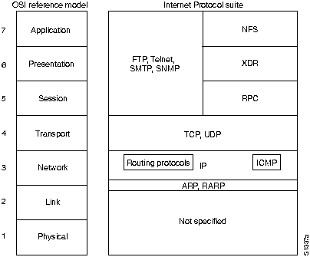
TCP/IP Network Architecture

Slide 34
IP Network Addresses
IP address is 32 bits in length, divided into either two or three parts:
  First part designates the host address
  Second part (if present) designates the subnet address
  Third part designates the host address

Slide 35
IP Network Addresses
IP addressing supports five different network classes:
  Class A: Mainly used with a few very large networks. Provide only 7 bits for the network address field.
  Class B: 14 bits for the network address field, 16 bits for the host address field. Offers a good compromise between network and host address space
  Class C: Allocate 22 bits for the network address field, provide only 8 bits for the host field. The number of host may be a limiting factor
  Class D: Reserved for multicast groups, the 4 highest-order bits are set to 1, 1, 1, and 0.
  Class E: Reserved for future use, the four highest-order bits are all set to 1.

Slide 36
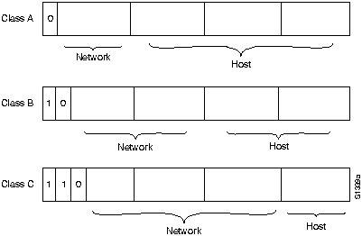
IP Network Addresses

Slide 37
TCP/IP Applications & Services
FTP ( File Transfer Protocol): Move files between computer systems.
Telnet ( Terminal Emulation Protocol): Allows virtual terminal emulation.
SMTP ( Simple Mail Transfer Protocol): Provides an electronics mail transport mechanism.
SNMP ( Simple Network Management Protocol): It is a network management used for reporting anomalous network conditions and setting network threshold values, SNMP Version 1 & 2.

Slide 38
TCP/IP Applications & Services
HTTP (Hypertext Transfer Protocol): Enables services to terminals running WWW clients and browsers.
NFS (Network File System): Allows transparent access to network resources. It includes three services:
  NFS (Network File System)
  XDR (Eternal Data Representation)
  RPC (Remote Procedure Call)

Slide 39
AppleTalk
Proprietary Standard Developed in 1985 and 1989 (Phase I & II)
Initially suited for local workgroups
Apple published standard to encourage third party development of applications and services.
Principle Contribution: Dynamic node assignment, Name binding, Logical groupings of networks
Implemented on major OSs (MacOS, Microsoft Windows, Unix)

Slide 40
AppleTalk
AppleTalk is a LAN system designed and developed by Apple Computer, Inc. It can run over Ethernet, Token Ring, and Fiber Data Distributed Interface (FDDI) networks, and over Apple's proprietary twisted-pair media access system (LocalTalk).
AppleTalk specifies a protocol stack comprising several protocols that direct the flow of traffic over the network. Apple Computer uses the name AppleTalk to refer to the Apple network protocol architecture.

Slide 41
AppleTalk
Apple Computer refers to the actual transmission media used in an AppleTalk network as:
  LocalTalk (AppleTalk over telephone wire)
  EtherTalk (AppleTalk over Ethernet)
  TokenTalk (AppleTalk over Token Ring)
  FDDITalk (AppleTalk over FDDI)

Slide 42
AppleTalk Phase 1
Phase 1: the earlier version, supports a single physical network that can have only one network number and be in one zone. Apple Talk Phase 1 was installed on over 1.5 million Macintosh computers in the first five years of the products life, however, Apple found that some large corporations were exceeding the built-in limits of Apple Talk Phase 1, so they enhanced the protocol.

Slide 43
AppleTalk Phase 2
Phase 2: the more recent version, supports multiple logical networks on a single physical network and allows networks to be in more than one zone. The enhanced protocol, known as Apple Talk Phase 2, improved the routing capabilities of Apple Talk and allowed it to run successfully in larger networks.

Slide 44
AppleTalk Protocols
Layers 6 & 7
  AFP - AppleShare File Server
  PostScript - PrintShare
Layers 5
  ADSP - AppleTalk Data Stream Protocol
  ZIP - Zone Information Protocol
  ASP - AppleTalk Session Protocol
  PAP - Printer Access Protocol

Slide 45
AppleTalk Protocols
Layers 4
  RTMP - Routing Table Maintenance Protocol
  AURP - AppleTalk Update-Base Routing Protocol
  AEP - AppleTalk Echo Protocol
  ATP - AppleTalk Transaction Protocol
  NBP - Name Binding Protocol
Layers 3
  DDP - Datagram Delivery Protocol
  AARP - AppleTalk Address Resolution Protocol

Slide 46
AppleTalk Protocols
Layer 2
  ELAP - EtherTalk Link Access Protocol
  LLAP - LocalTalk Link Access Protocol
  TLAP - TokenTalk Link Access Protocol
  FLAP - FDDITalk Link Access Protocol
Layer 1
  LocalTalk
  EtherTalk
  TokenTalk
  FDDITalk

Slide 47
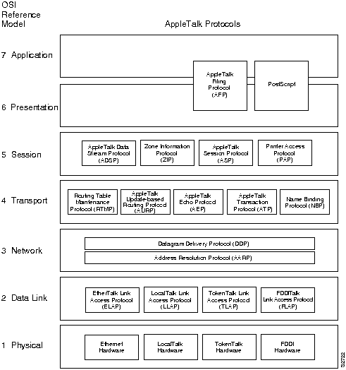
AppleTalk Network Architecture

Slide 48
AppleTalk Protocol Functions
DDP
  Connectionless
  Segmentation of upper layer PDU’s
  Four field header: [Address header:Hop count:Data:Checksum]
AARP
  Translates network address to physical addresses
  Dynamic node assignment: Broadcasts random node selection, Conflict - try again, Minimal user intervention

Slide 49
AppleTalk Protocol Functions
RTMP
  Updates and maintains routing tables in routers
  Five fields: [Network Number:Distance in hops:Router port to destination:ID of next router to destination:Network status]
  Updated by broadcast every 10 seconds
ATP
  Single Direction communications
  Destination Reply Packet
  Handles: Lost Packets, Delayed packets, Destination down

Slide 50
AppleTalk Protocol Functions
AEP
  Tests reachability of remote node
  Similar to Ping
NBP
  Resolves addresses
  Distributed database
  Supports zones

Slide 51
AppleTalk Protocol Functions
ZIP
  Zone Information Tables (ZIT)
  Similar to routing tables
ADSP
  Socket-to-socket connection control
  Flow Control
  Ordered Delivery

Slide 52
Novell NetWare Protocols
Introduced for IBM computers
Developed from XNS
Introduced in 1980’s
Dominant LAN architecture - 65% market
Runs on most major OS: Microsoft Windows, MacOS, UNIX

Slide 53
Novell IPX
Novell IPX (Internetwork Packet Exchange): NetWare’s network layer protocol used for transferring data from servers to workstations.
IPX is derived from the Xerox Network Systems (XNS) Internet Datagram Protocol (IDP).

Slide 54
Differences Between IPX & XNS
IPX and XNS do not always use the same Ethernet encapsulation format.
IPX uses Novell's proprietary Service Advertisement Protocol (SAP) to advertise special network services. File servers and print servers are examples of services that are typically advertised.
IPX uses delay, measured in ticks, while XNS uses hop count as the primary metric in determining the best path to a destination.

Slide 55
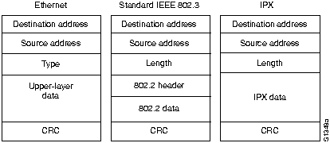
IPX Packet Format

Slide 56
Novell NetWare
Specifies upper five layers of OSI
Independent of physical media. Drivers for: Ethernet, Token Ring, FDDI, ARCnet, PPP, etc.

Slide 57
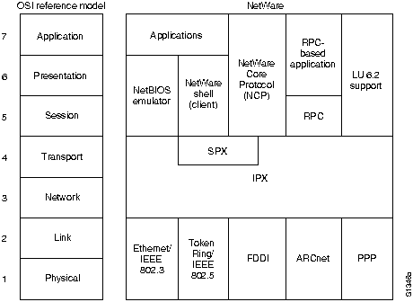
Novell Network Architecture

Slide 58
IPX Packet
Checksum
Length
Transport Control
Packet Type
Destination Network
Destination Host
Destination Port
Source Network, Host, Port

Slide 59
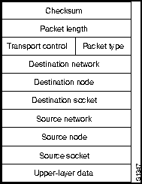
IPX Packet

Slide 60
Novell NetWare Protocols
IPX
  IPX (Internet Packet Exchange) derived form XNS
  Network and Transport Layers (Layers 3 & 4) Interface
  Connectionless routing protocol
  Routes Datagrams through intermediate networks
SAP
  SAP (Service Advertising Protocol)
  Servers learn about available services
RIP
  RIP (Routing Information Protocol)
  Same Protocol used in TCP/IP

Slide 61
Novell NetWare Protocols
SPX
  SPX (Sequenced Package Exchange) derived from XNS Sequenced Packet Protocol (SPP)
  Transport Layer (Layer 4) Interface
  Connection oriented
  Verifies integrity of data
NetBIOS
  NetBIOS (Network Basic Input Output System)
  Session and Presentation Layers (Layers 5 & 6)
  Interface for IBM and Microsoft

Slide 62
XNS (Xerox Network System)
Protocol suite originally designed by Xerox Corporation in late 1970’s. Many PC networking companies, such as 3Com, Banyan, Novell, and Ungermann-Bass Networks used or currently use a variation of XNS as their primary transport protocol.
XNS was designed to be used across a variety of communication media, processors and office applications.
UB, (now a part of Tandem Computers) adopted XNS in developing its Net/One XNS routing protocol.

Slide 63
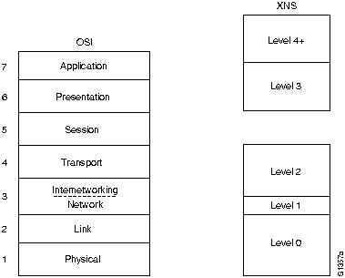
XNS Network Architecture

Slide 64
IDP Packet Format
Checksum: A 16-bit field that helps gauge the integrity of the packet after it traverses the internetwork.
Length: A 16-bit field that carries the complete length (including checksum) of the current datagram.

Slide 65
IDP Packet Format
Transport control: An 8-bit field that contains hop count and maximum packet lifetime (MPL) subfields. The hop count subfield is initialized to zero by the source and incremented by one as the datagram passes through a router. When the hop count field reaches 16, the datagram is discarded on the assumption that a routing loop is occurring. The MPL subfield provides the maximum amount of time, in seconds, that a packet can remain on the internetwork.

Slide 66
IDP Packet Format
Packet type: An 8-bit field that specifies the format of the data field.
Destination network number: A 32-bit field that uniquely identifies the destination network in an internetwork.
Destination host number: A 48-bit field that is uniquely identifies the destination host.
Destination socket number: A16-bit field that uniquely identifies a socket (process) within the destination host.

Slide 67
IDP Packet Format
Source network number: A 32-bit field that uniquely identifies the source network in an internetwork.
Source host number: A 48-bit field that is uniquely identifies the source host.
Source socket number: A16-bit field that uniquely identifies a socket (process) within the source host.

Slide 68

IDP Packet Format

Slide 69
DECnet
Digital Equipment Corporation (Digital) developed the DECnet protocol family to provide a well-thought-out way for its computers to communicate with one another. The first version of DECnet, released in 1975, allowed two directly attached PDP-11 minicomputers to communicate.

Slide 70
DECnet
In more recent years, Digital has included support for nonproprietary protocols, but DECnet remains the most important of Digital's network product offerings.
DECnet is currently in its fifth major product release (sometimes called Phase V and referred to as DECnet/OSI in Digital literature).

Slide 71
DECnet
DECnet Phase V is a superset of the OSI protocol suite and supports all OSI protocols as well as several other proprietary and standard protocols that were supported in previous versions of DECnet. As with past changes to the protocol, DECnet Phase V is compatible with the previous releases (i.e. Phase IV).
Digital Equipment Corporation designed the DECnet stack of protocols in the 1970s as part of its Digital Network Architecture (DNA).

Slide 72
DECnet
DNA supports DECnet routing over Ethernet, Token Ring, FDDI, HDLC, Point-to-Point Protocol (PPP), Frame Relay, Switched Multimegabit Data Service (SMDS), X.25, and IEEE 802.2.
DECnet supports both connectionless and connection-oriented network layers implemented by Open System Interconnection (OSI) protocols.

Slide 73
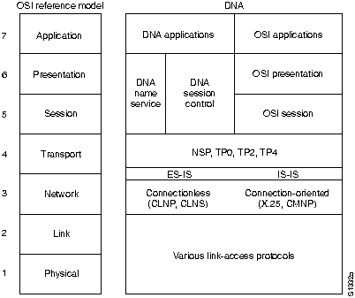
DECnet Network Architecture

Slide 74
DECnet
Phase V is compatible with the previous release, Phase IV. Phase IV was similar to OSI routing, but Phase V implements full OSI routing including support for End System-to-Intermediate System (ES-IS) and Intermediate System-to-Intermediate System (IS-IS) connections.
An End System (ES) is a nonrouting network node; an Intermediate System (IS) refers to a router. ESIS support allows ESs and ISs to discover each other. IS-IS provides routing between ISs only.

Slide 75
DECnet
DECnet Phase IV Prime supports inherent MAC addresses, which allows DECnet nodes to coexist with systems running other protocols that have MAC address restrictions.

Slide 76
Banyan VINES
The Banyan Virtual Network System (VINES) protocol is a networking system for personal computers.
This proprietary protocol was developed by Banyan Systems, Inc., and is derived from the Xerox Network System (XNS) protocol.

Slide 77
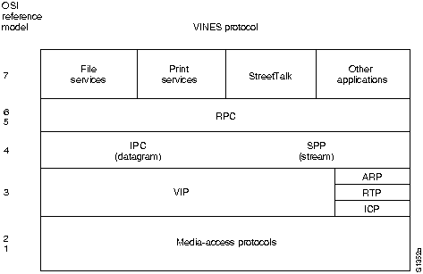
Banyan VINES Network Architecture

